Slide 1
Easy Counselling App
An app to help VIT students reach counsellors

Slide 2
Introduction
What does this app do?
This app is designed for the people who are going through depression, anxiety, loneliness, stress and all other problems that are really sensitive to speak of.
It acts as a virtual medium of communication between a student and a counsellor.
Notes:
Easier to maintain and app size would be small and we are not going to include all the video stuff in the counselor side

Slide 3
How did we get this idea?
As former first year student ourselves we first hand have the experience on how difficult it is to blend inside the general community and how insecure we all are in the start.
Being in college and staying with new faces is a really big change for us and some of us cope with it but some cannot.
Getting to know such friends who are unable to cope up with the dwindling stress of assignments and exams,new environments and separation from parents is the sole idea behind this app.
Notes:
How is it gonna help the people say it

Slide 4
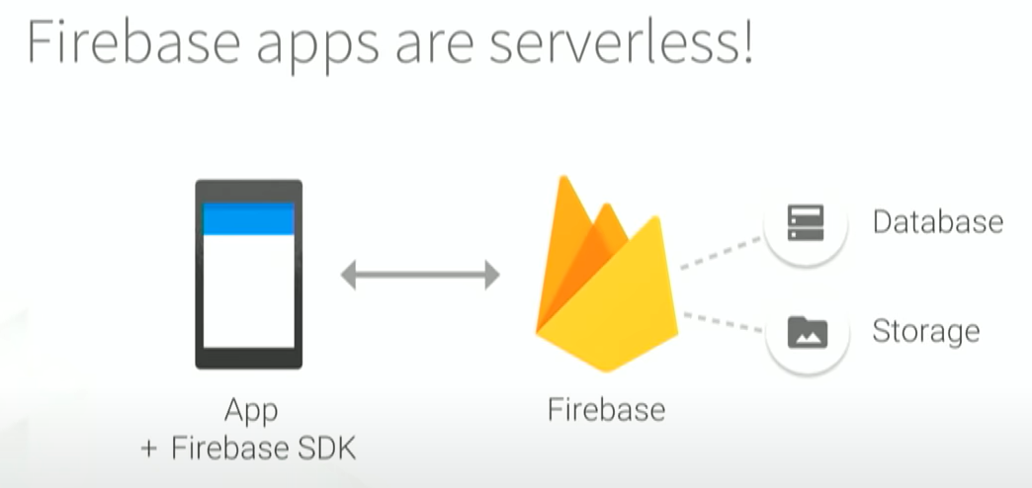
Firebase - The Spine of our App
A backend as a service platform developed by Google
Scalable, secure and used by millions of developers
Powers authentication and database

Slide 5
Basic App Design
Firebase
Student Application
Counsellor Application
Forms
Motivational Content
Chats
Chats
Statistics

Slide 6
Authentication - Options Considered
Aim: Ensure user is a VIT student
Options Considered | Merits | Drawbacks
Anonymous | Great for user privacy | Anyone can use the app
Register Number | Ensures user is a VIT student | Data required from concerned department
VIT Email | Ensures user is a VIT student | No data required

Slide 7
Authentication - Powered by Firebase
User Login
Counsellor Login
Register with VIT Email
Check email against database
Check for @vitstudent.ac.in/@vit.ac.in
Password
Authenticate
Send verification link
Authenticate
Only VIT Students can use this app

Slide 8
Authentication - Technical Details
Firebase Initialization
Create and launch sign-in intent
onActivityResult
returns a Unique ID

Slide 9
Chat Priorities
Simple to use
Secure
Update in real time
Extra features can easily be added in the future

Slide 10
App Flow
Login
Verify Email
Fill out questionnaire
Request a counsellor
Start talking

Slide 11
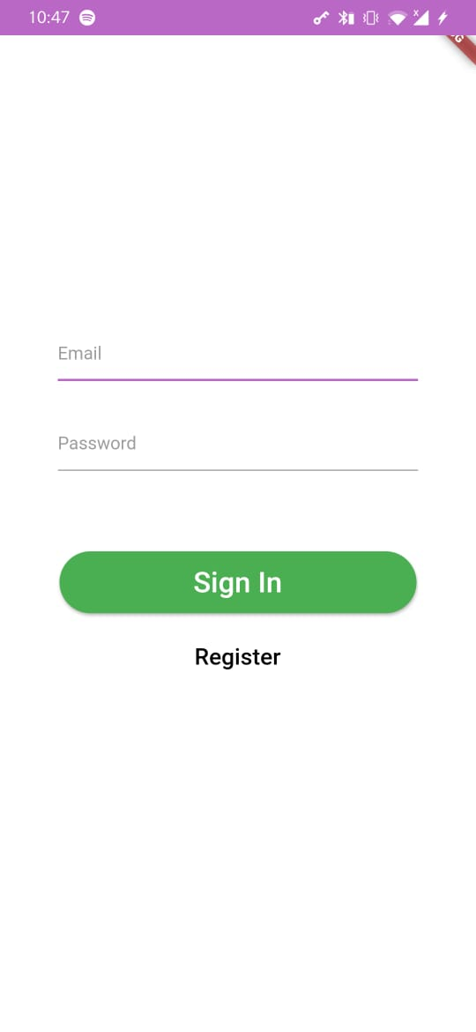
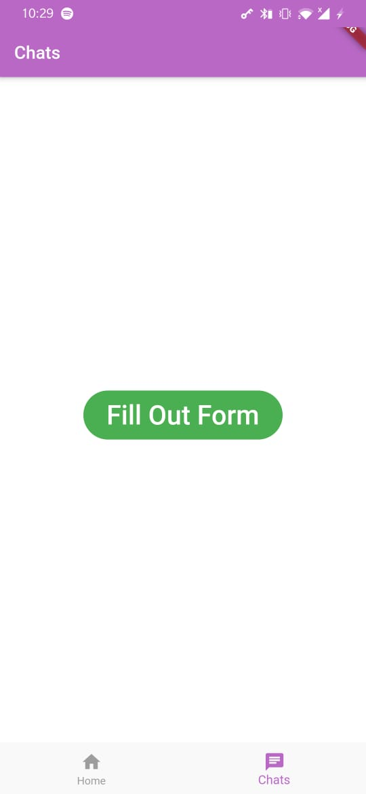
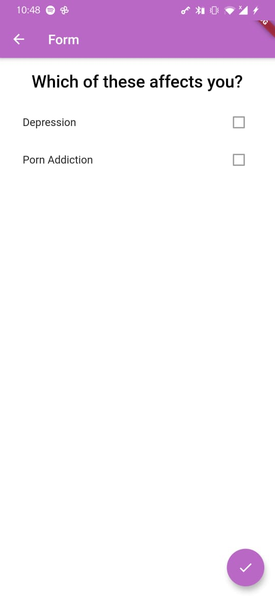
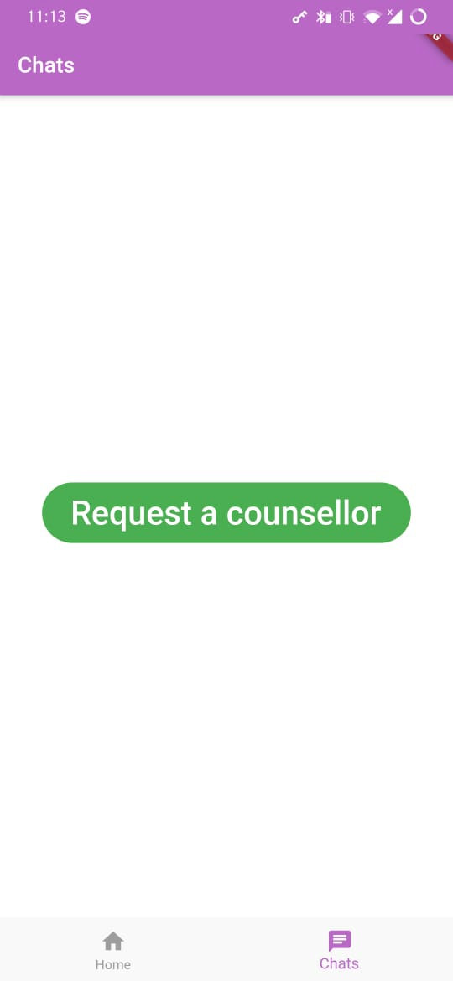
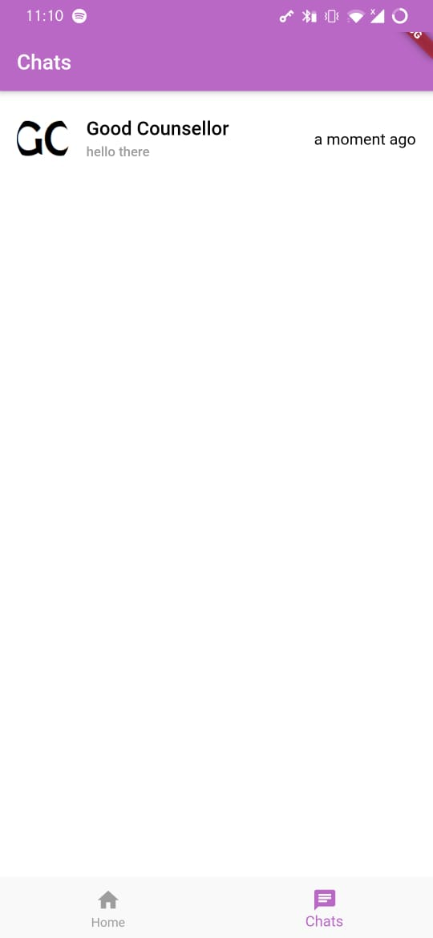

Slide 12
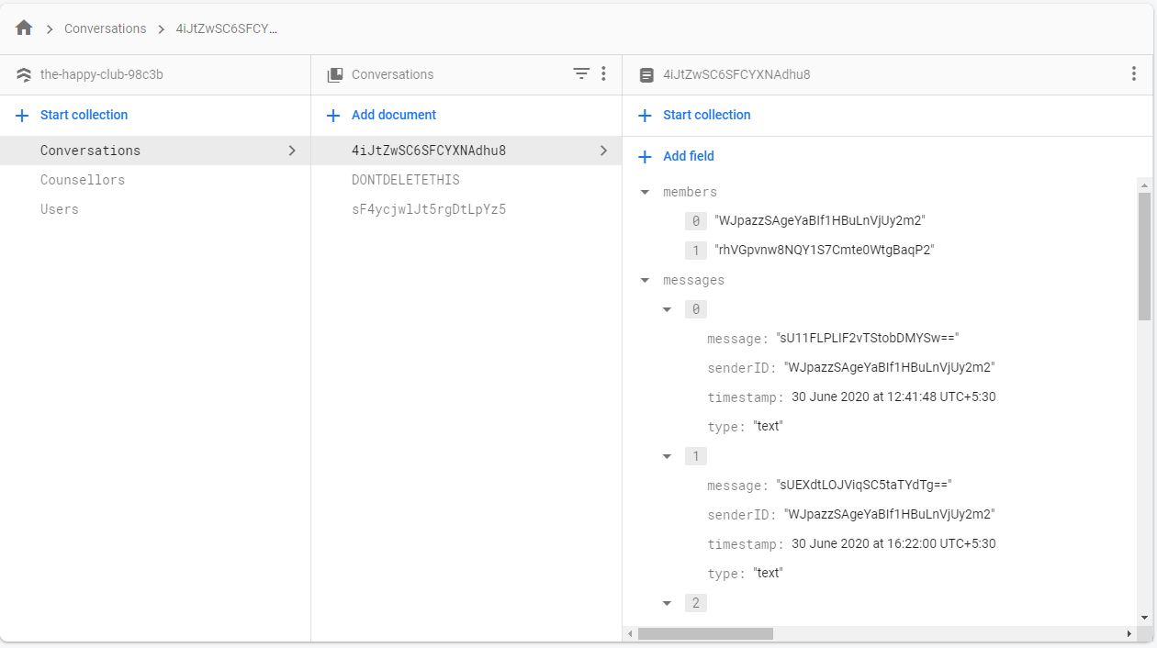
Database - Structure

Slide 13
Encryption
Text
Encryption
Unreadable text
Messages can only be read by Student and Counsellor
Each conversation has a unique encryption key (Similar to Whatsapp)

Slide 14
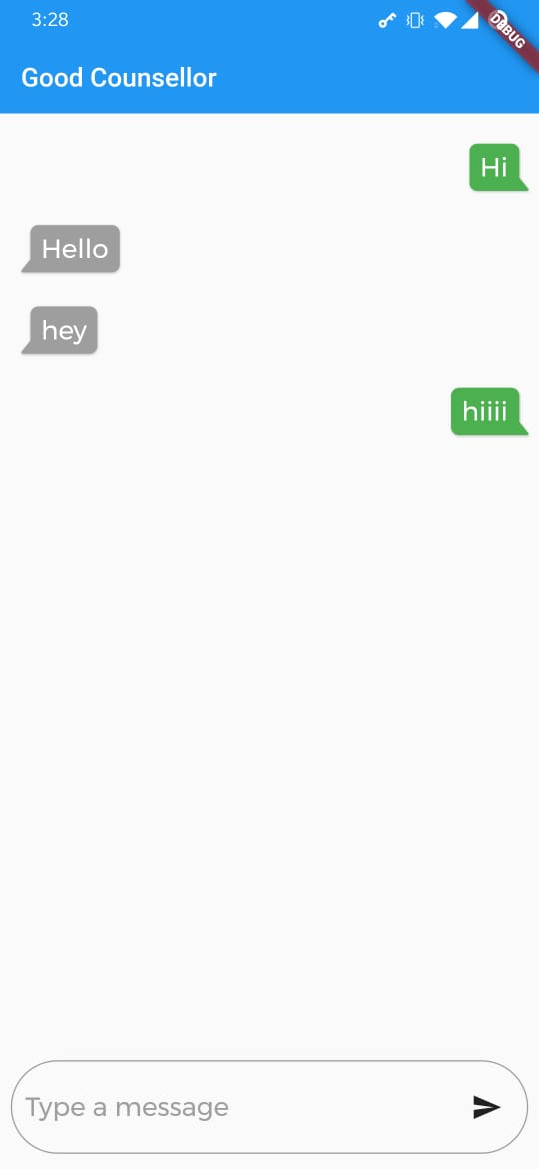
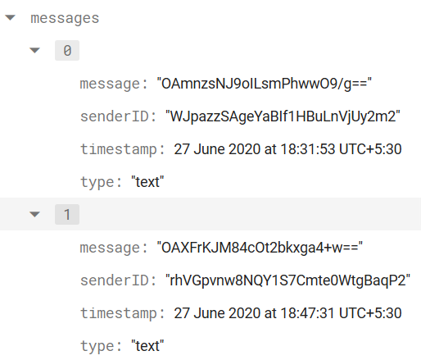
App
Database

Slide 15
Current Development Plan
Chatbox Features - search in text, scroll bar
Biometric Authentication
Testimony / Feedback Page
Sending documents
User friendly error messages
License page

Slide 16
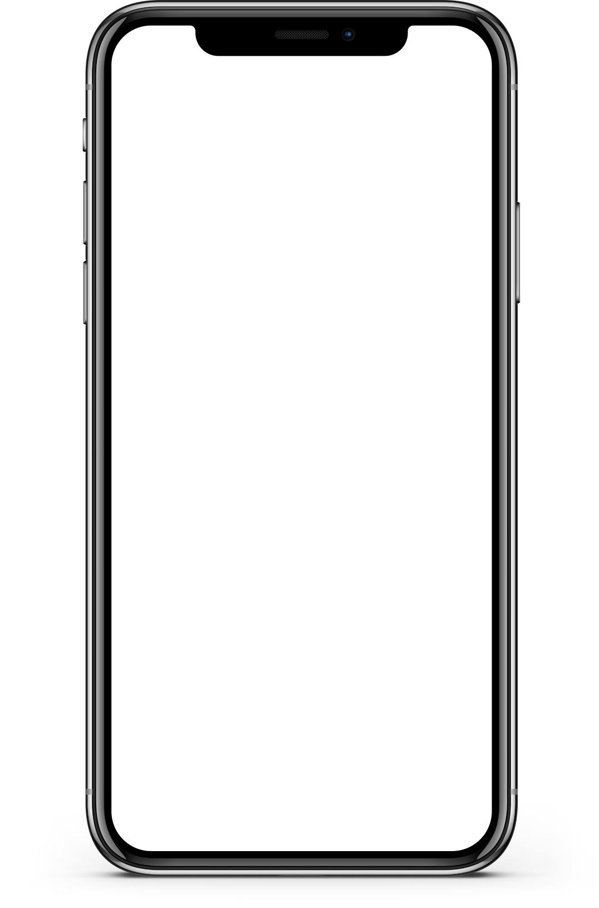
Developing for iOS
Code written will work on iOS
Cannot test or compile apps without a Mac device
Exploring potential workaround
Lower priority

Slide 17
Pricing
Notes:
Actual cost can only be estimated aftter a trial run of the app

Slide 18
Pricing
Pricing
Registration Cost
Running Cost
App Store
Play Store
Firebase
$99 Annually
$25 One time
~₹7600
~₹1900

Slide 19
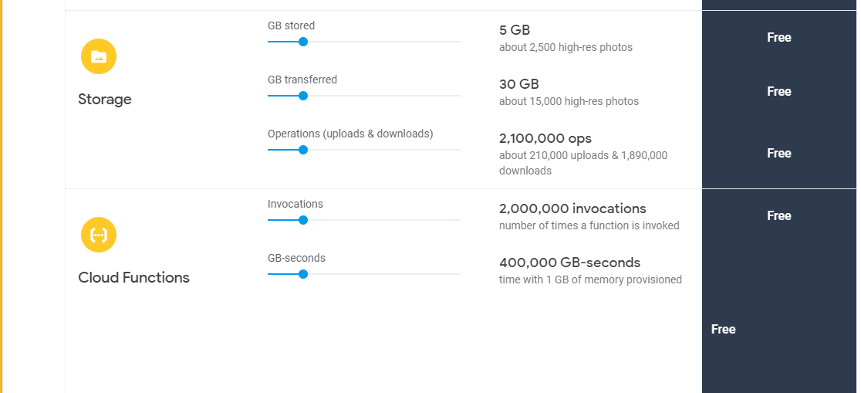
Firebase Free Quota
Cloud Firestore offers free quota that allows you to get started at no cost. The free quota amounts are listed below

Slide 20
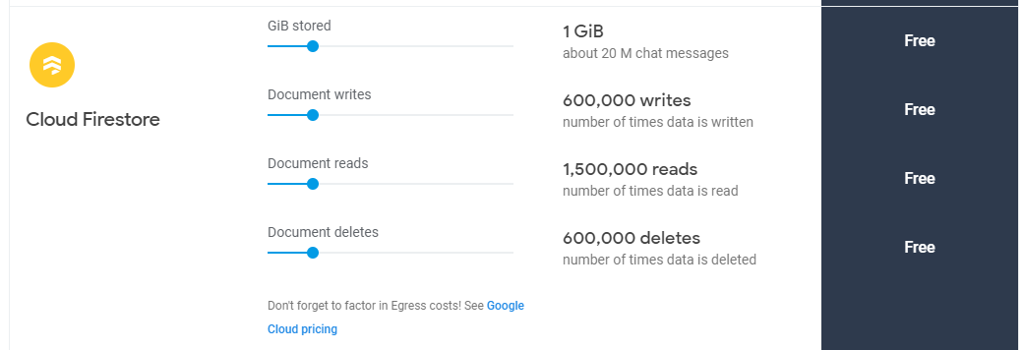
Firebase Price Scaling
When you use Cloud Firestore, you are charged for the following:
The number of reads, writes, and deletes that you perform.
The amount of storage that your database uses, including overhead for metadata and indexes.
The amount of network bandwidth that you use.
Cloud Firestore offers free quota that allows you to get started at no cost. The free quota amounts are listed below

Slide 21
Firebase price scaling after crossing the threshold
100k reads = $.06 (4.5 rupees)
100k writes = $.18 (14 rupees)
100k deletes = $.02 (1.5 rupees)
Stored data per month = $0.18/GB (14 rupees)
The firebase pricing can only be estimated accurately once the app has been released.

Slide 22
Rough Estimate of Prices (hypothetical approach)
Assuming 500 daily active users where one person has 100 reads
In order to check what the pricing of firebase would be,we would first calculate how many people can accomodate inside 15,00,000 reads because reads below 15,00,000 are provided free by firebase. So since one person can accomodate 100 reads, Therefore 15,000 people can accommodate 15,00,00 reads. Now since our app is going to accomodate 500 daily new users Therefore our app would work for free forever assuming we have 500 daily users. Hence our app is going to be basically free forever in case of reads if one person has 100 reads respectively

Slide 23
Rough Estimate of Prices (hypothetical approach)
Assuming 500 daily active users where one person has 50 writes
In order to check what the pricing of firebase would be,we would first calculate how many people can accomodate inside 6,00,000 writes because writes below 6,00,000 are provided free by firebase. So since one person can accomodate 50 writes, Therefore 12,000 people can accommodate 6,00,000 writes Now since our app is going to accomodate 500 daily new users Therefore our app would work for free forever assuming we have 500 daily users. Hence our app is going to be free in case of writes if one person has 50 writes

Slide 24
Roadmap of our app
Core features ~ 75% implemented
Making everything production ready - friendly and easy to use toast messages and features
Private test build for Android by first week of October

